Slide 1
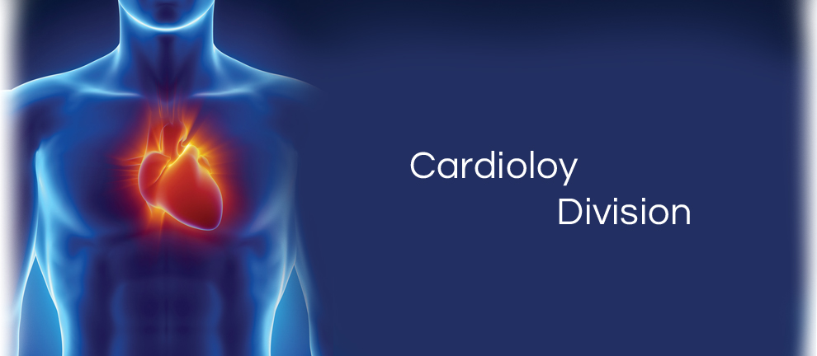
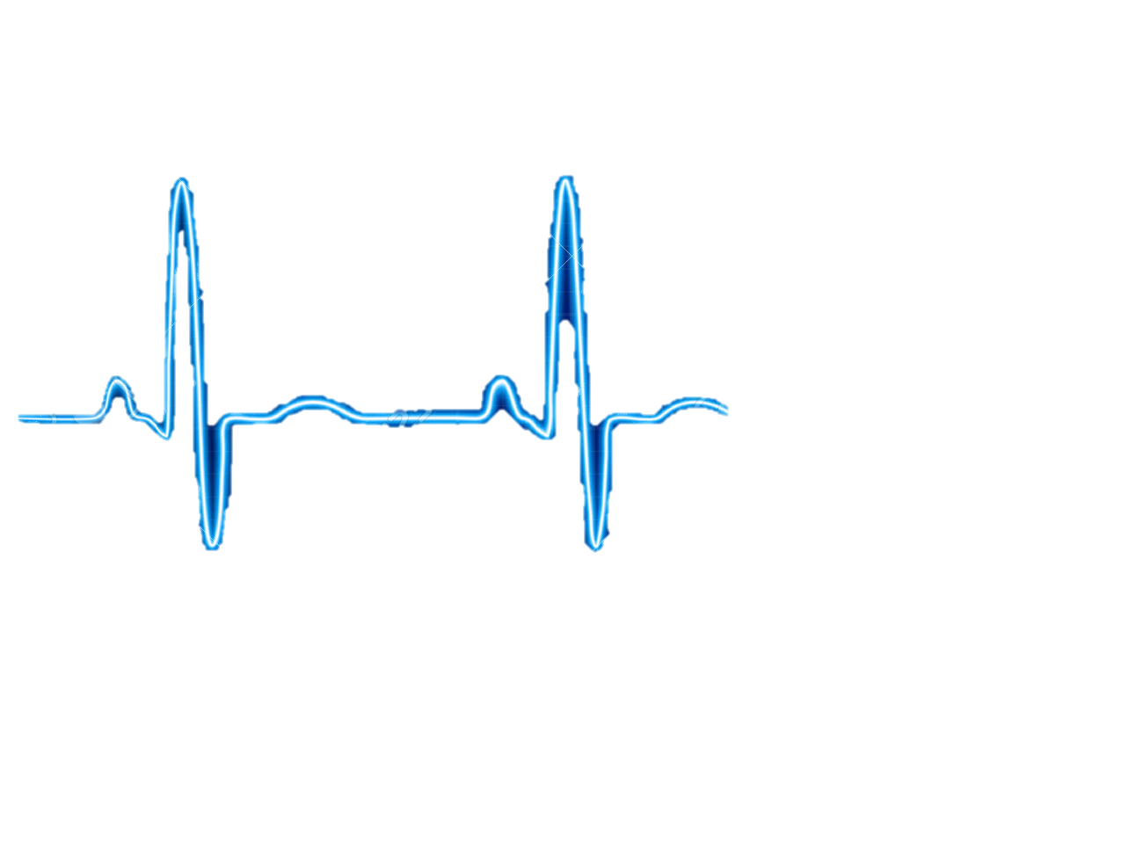
Concept Presentation
CARDIOVASCULAR TEAM
Qingbo Kang
Arthur Kohler
Chantelle Janeiro
Naghmeh Bandari
December, 2017

Slide 2
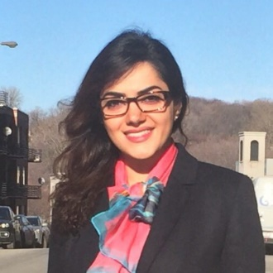
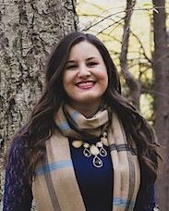
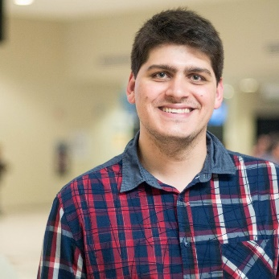
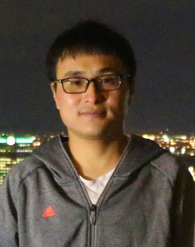
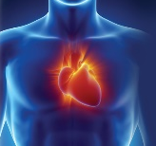

TEAM MEMBERS
Naghmeh Bandari:
- PhD. Student of Mechanical engineering, Concordia University (2016-Now)
- Therapy Development Specialist, CoreValve® TAVI, Medtronic® lnc. (2010-2015)
- Commerce and Regulatory Affairs Supervisor, Thoratec Corp. (2007-2010)
Chantelle Janeiro:
- MSc., Year 1, McGill University, Department of Experimental Medicine (Present)
Supervisor: Dr. Lorenzo Ferri; Research: Gastric Adenocarcinoma Peritoneal Metastasis
- BMSc., University of Western Ontario (2012-2017), Microbiology and Immunology
Arthur Kohler:
- Master Student in Engineering, with a concentration in Healthcare , ÉTS (2016-Now)
- Student in Biomedical Engineering, University of Technology of Compiègne, France (2014-Now)
Qingbo Kang:
- Master Student of Computer Science, Concordia University (2017-Now)

Slide 3
Need Statements
A way to determine the size of a heart valve, in patients with cardiac valve dysfunction in order to: increase the accuracy and speed of choosing the proper valve; and decrease hospital expenditure and post-operative complications of transcatheter valve replacement.

Slide 4
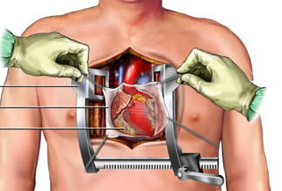
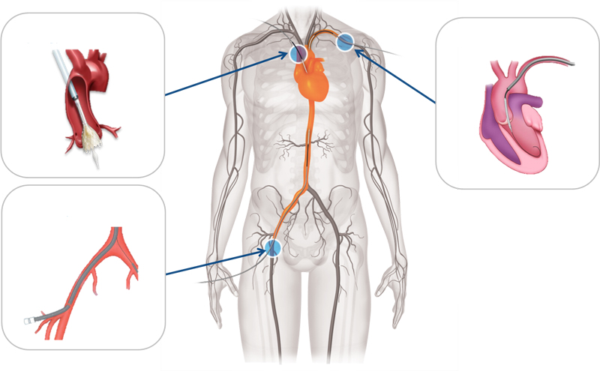
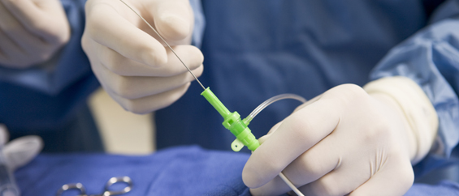
Treatment for Heart Valve Disorder
Transcatheter Valve Replacement
Open Surgery
Stop heart beating
Use of heart-lung machine
Several weeks of recovery
Less pain
Less infection
Low-risk patients may leave same day

Slide 5
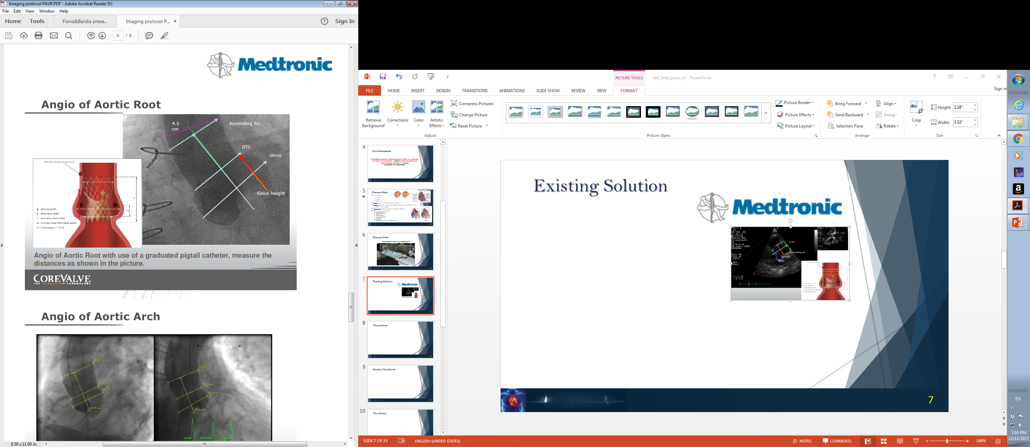
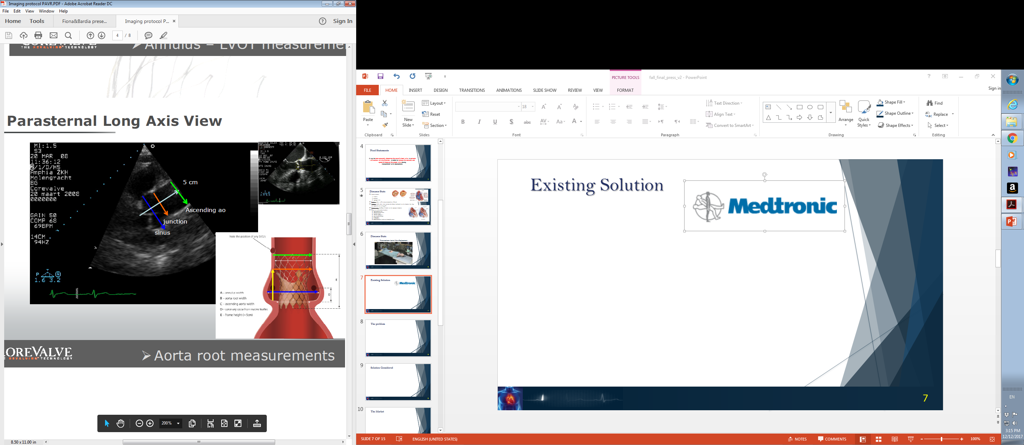
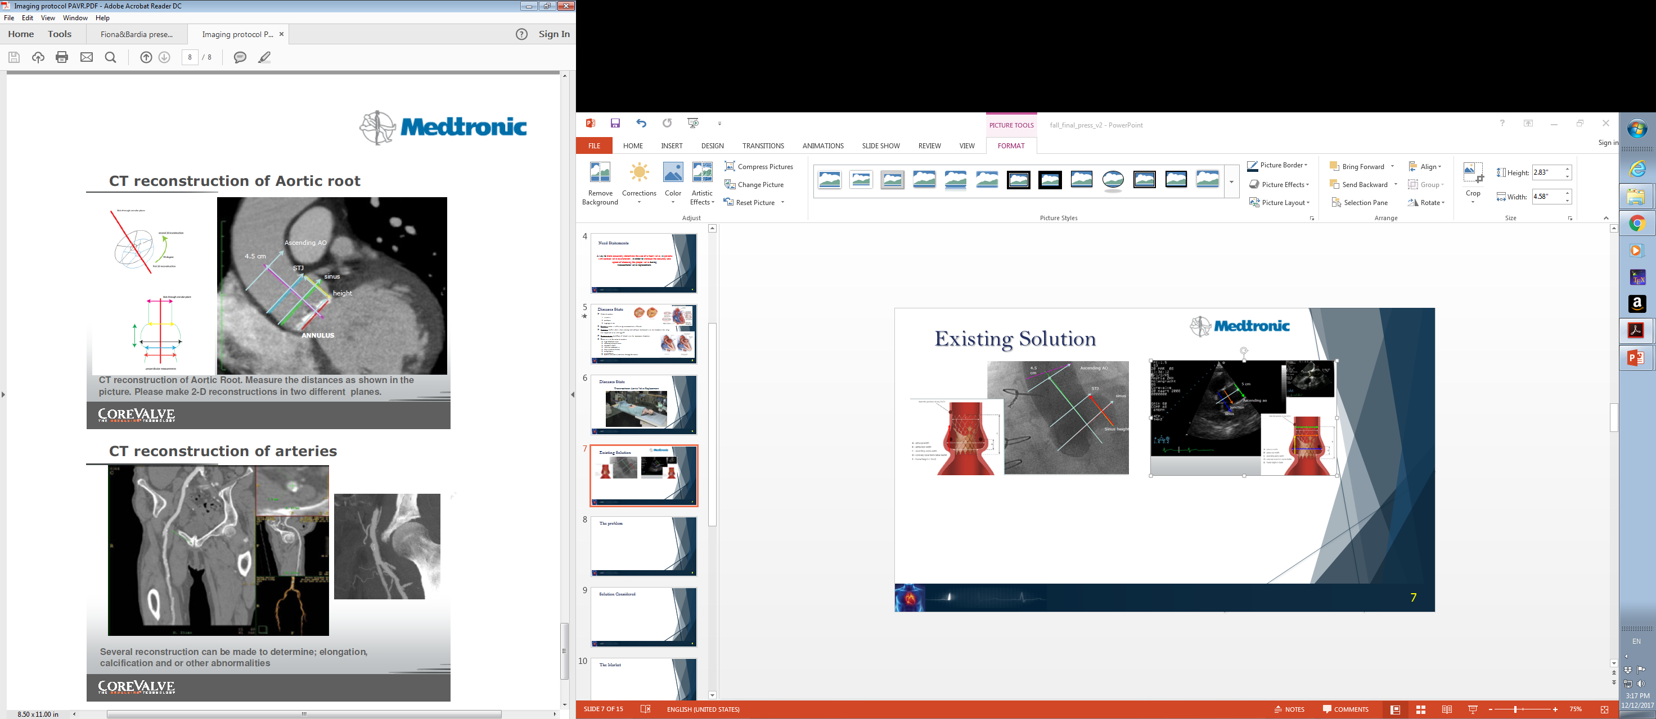
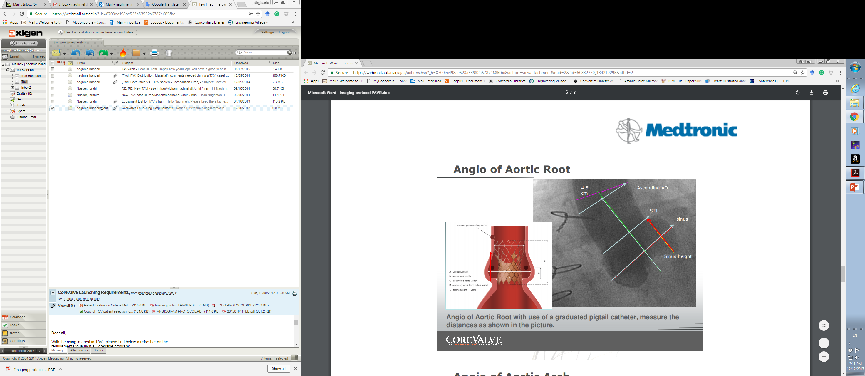
Existing Solutions
Contrast Angiogram
Echocardiography
CT Reconstruction of Aortic Root

Slide 6
Current problem
Cost
Accuracy
Health Risk
Time
Contrast agent
Paravalvular regurgitation
Valve migration
Intraoperative accessibility
Running expenses
Capital investment
X-ray exposure

Slide 7
Classification and Regulations
Balloon Aortic Valvuloplasty catheter
Device Classification: II Product Code: OZT Regulation Number: 870.1255
Need Criteria:
Have to be able to insert a diagnostic tool into a valve that may be highly calcified
Should be able to take a 360° measurement of the valve diameter for sizing
Inflatable design
Electrically passive
Inexpensive

Slide 8
Mechanical Design
“AnnuloFit”

Slide 9
Sensing Principle
Light Source
x
x
Multiple points
x
x
Continuous Sweep
Quarter Sweep
Optical Processing

Slide 10
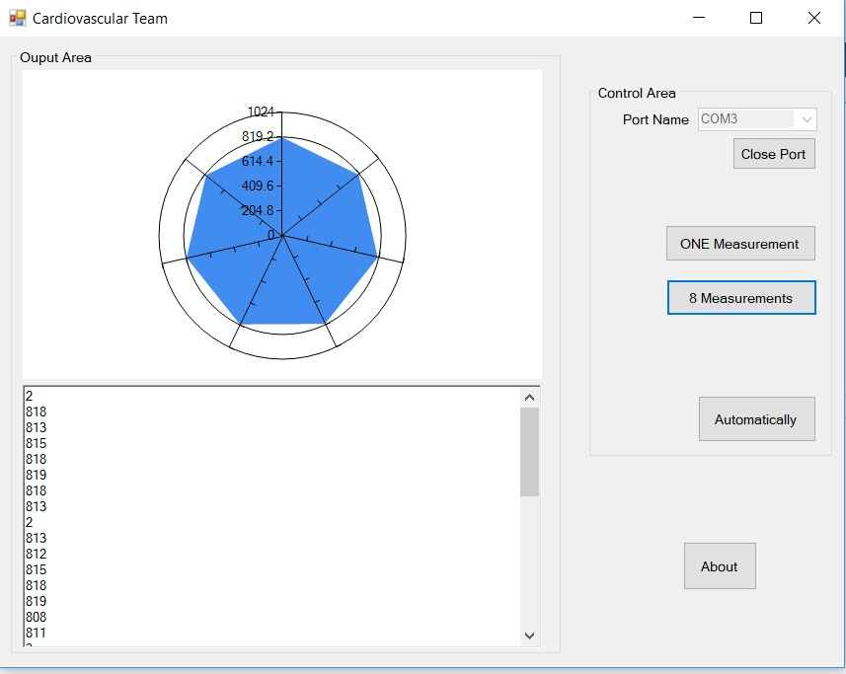
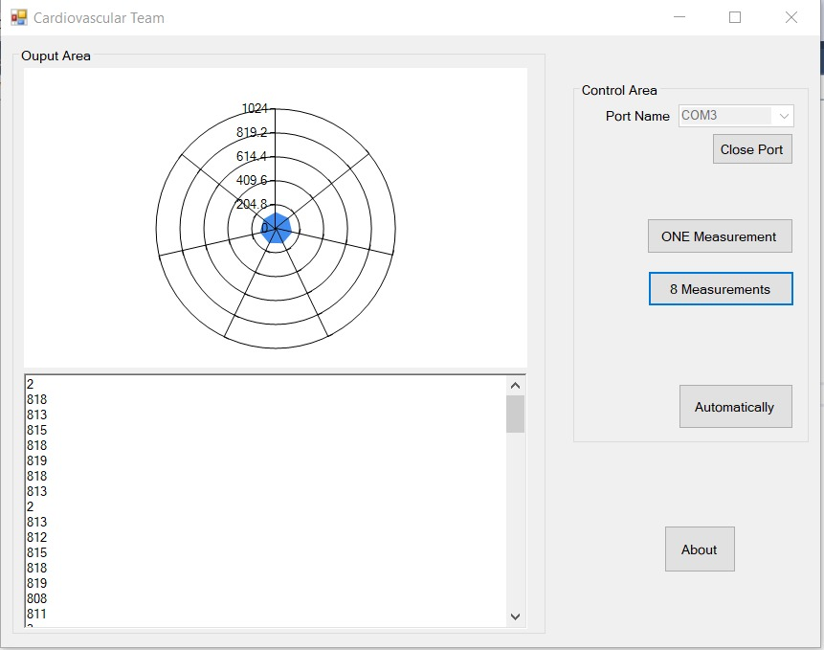
Output

Slide 11
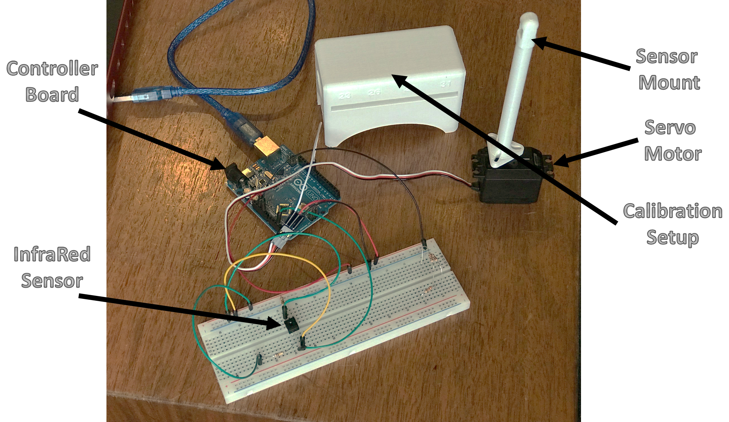
Experimental Setup – Sensor Calibration and Validation
11

Slide 12
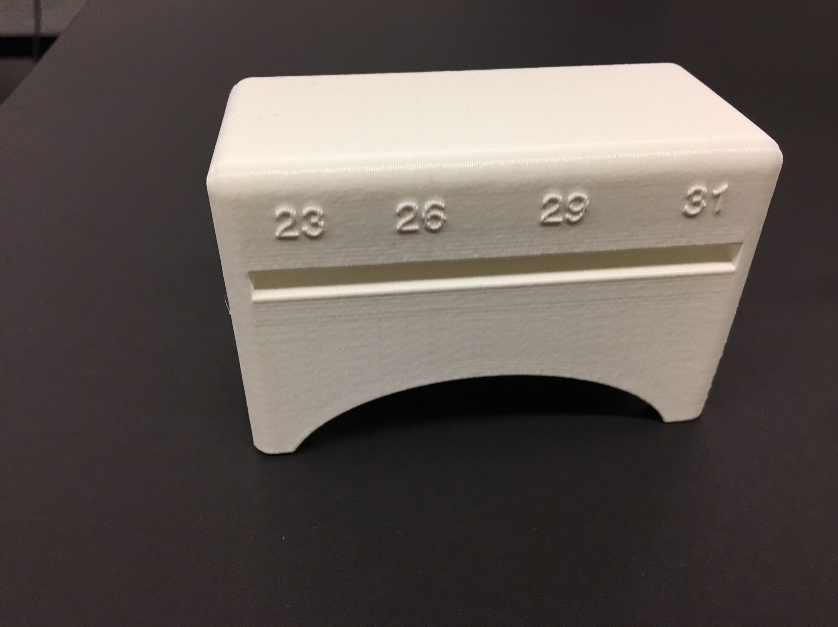
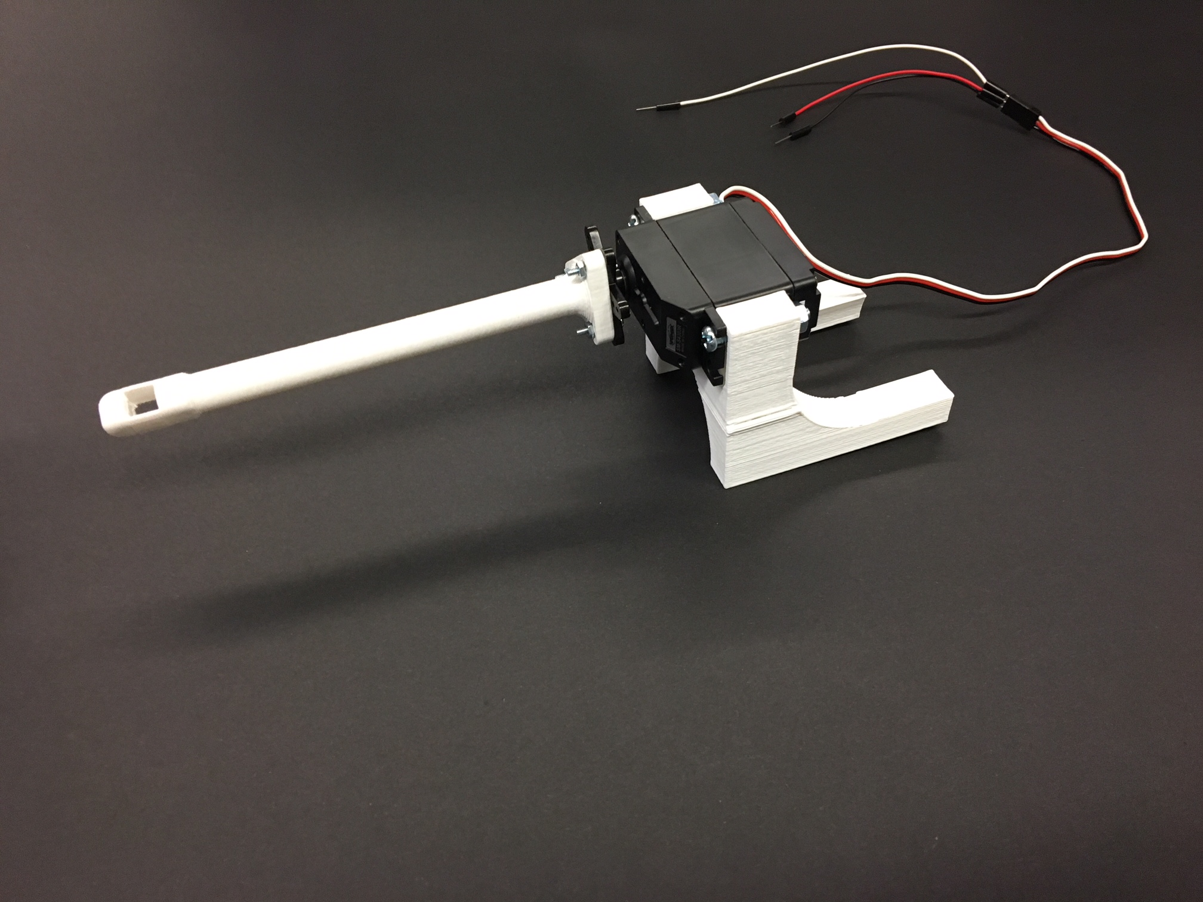
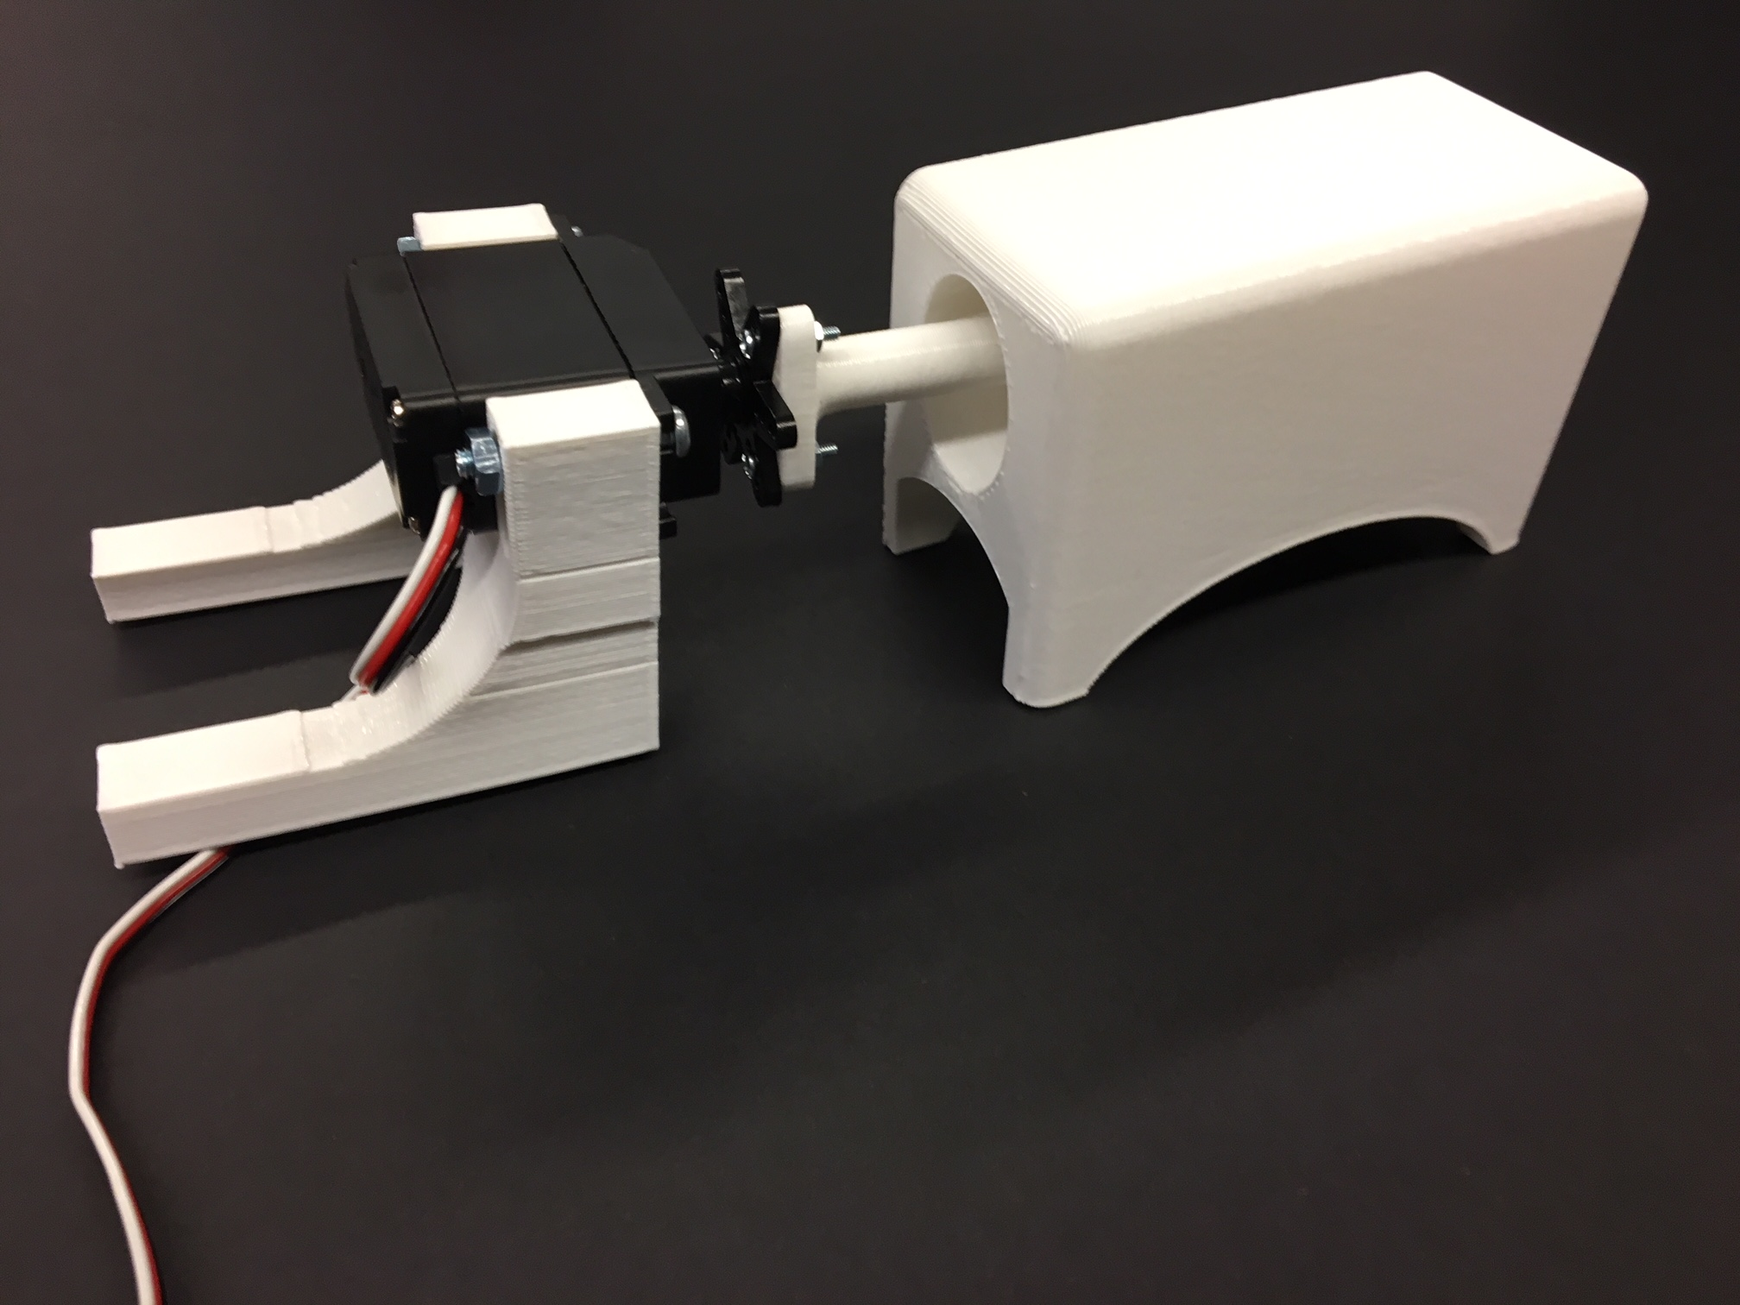
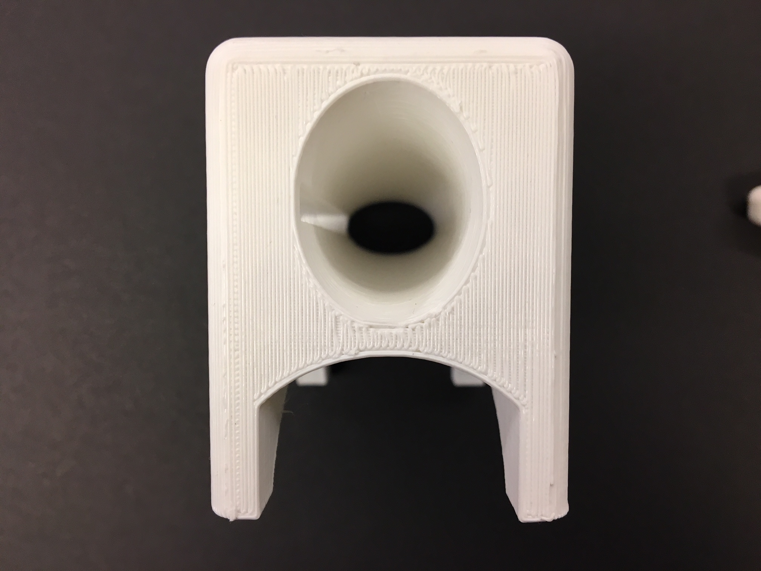
Experimental Setup – Sensor Calibration and Validation
+
=

Slide 13
The Market
67,500
aortic valve replacements
106,000 valve surgeries in U.S. each year
Valvular Disease Trends
Aortic stenosis is the most common valvular heart disease in developed countries.
Impact on public health and health care resources is expected to increase due to aging Western populations.
By 2050, 1.4 million patients will have symptomatic severe aortic stenosis in North America.

Slide 14
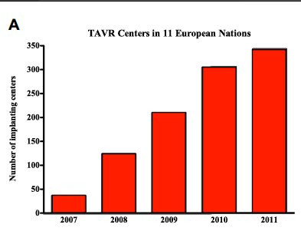
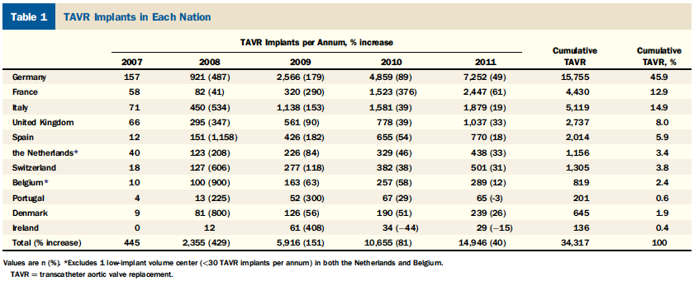
The Market
Prevalence of TAVR in Europe
11 study nations in Europe
Highest number of TAVR implants in Germany and France

Slide 15
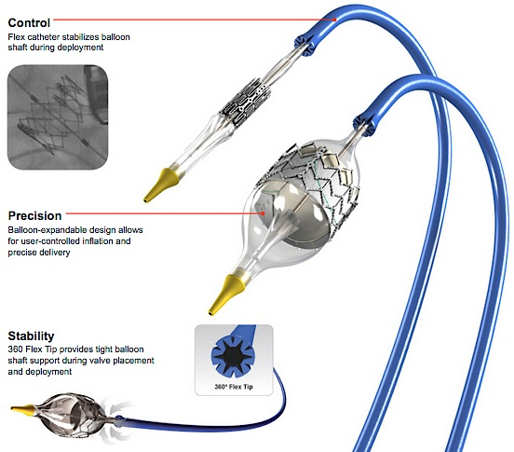
Cost effectiveness of proper balloon sizing
Cost of valvuloplasty balloon
$1,040
Edwards-Sapien Valve | $37,606
Coronary Angiogram | $9,007
CT Scan w/w.o. Contrast | $963
Echocardiogram | $1,425
TOTAL | $49,001

Slide 16
Potential Revenue
Cost of valvuloplasty balloon
$1,040
aortic valve replacement in US/year
67,500
$70,200,000
This is a conservative balloon cost because a balloon with biocompatible sensors would be much more costly!

Slide 17



Path to Market
Continued Prototype validation and verification
File for Provisional Patent
Clinical trials + FDA/CE/Health Canada feedback
Attracting attention of customers/users through product demo at conferences
Further patenting + presenting to companies for sale of the IP (exit)

Slide 18
CARDIOVASCULAR TEAM
Thank You…

